Slide 1
Lecture 26 – Heaps and Heapsort
CST370 – Design & Analysis of Algorithms
Dr. Byun
Computer Science

Slide 2
Lecture Objectives
After completion of this lecture, you will be able to
  explain the definition of the heap and conduct the heapsort.
  add a new item to the heap and remove the maximum value from the heap.

Slide 3
Chapter 6: Transform-and-Conquer
6.1 Presorting
6.2 Gaussian Elimination
6.3 Balanced Search Trees
6.4 Heaps and Heapsort
6.5 Horner’s Rule and Binary Exponentiation
6.6 Problem Reduction

Slide 4
Priority Queue
Priority queue is an abstract data type with the following three primary operations.
  Finding an item with the highest (or lowest) priority.
  Deleting an item with the highest (or lowest) priority.
  Adding a new item.
It’s very useful in many applications such as a simulation, a job scheduling, etc.

Slide 5
Heap
Heap is a good implementation of the priority queue.
Using it, you can do the three operations very efficiently.
  Find the max value (or min value) : O(1)
  Remove the max (or min) : O(log n)
  Insert a number: O(log n)

Slide 6
Introduction to (Max) Heap
A (max) heap is a binary tree with the following two conditions.
  It should be a complete tree.
  The value of each node must be greater than or equal to the values of its children.
    It is called the max heap because the parent has a larger (or equal) value than its children.
    There is another type of heap called min heap.
In the class, we will focus on max heap.

Slide 7
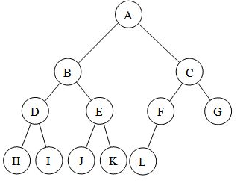
Complete Binary Tree
A complete binary tree is a binary tree in which every level, except possibly the last, is completely filled, and all nodes in the last level are as far left as possible.
Example

Slide 8
Heap Example (1 of 2)
70
30
50
10
20
This is the max heap (or just heap in this class) because it meets two conditions.
  The binary tree is complete.
  Each node has a value greater than or equal to its children.
    70 is greater than 30 and 50.
    30 is greater than 10 and 20.

Slide 9
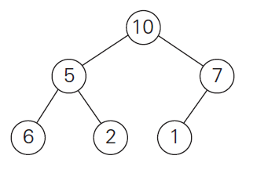
Heap Example (2 of 2)
This is a not heap.
  The tree is complete.
  However, 6 is greater than 5. Therefore, the second condition was violated.

Slide 10
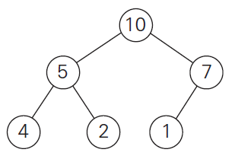
Exercise (1 of 2)

Slide 11
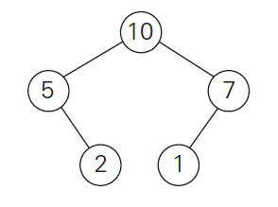
Exercise (2 of 2)

Slide 12
Find the max value in the heap
Root value of a heap must be the maximum value.
  Otherwise, it’s the violation of heap definition.
Therefore, the maximum value can be found at a constant time (= O(1)).

Slide 13
<<< Course Instruction >>>
Watch this video to understand how you can add a new value to the heap.
  http://y2u.be/c1TpLRyQJ4w (Length - 5:07)
  Note that the addition operation can be done in O(log n).

Slide 14
Exercise
Add 45 to the following heap.
70
30
50
10
20

Slide 15
Exercise
Add 75 to the following heap.
70
30
50
10
20
45

Slide 16
<<< Course Instruction >>>
Watch this video to understand how you can remove a max value from the heap.
  http://y2u.be/ijfPvX2qYOQ (Length - 4:12)
  Note that the operation can be performed in O(log n).

Slide 17
Exercise
Remove the max value from the heap.
75
30
70
10
20
45
50

Slide 18
Exercise
Remove the max value from the heap.
9
8
6
2
5
1

Slide 19
Heapsort
Heap sorting can be done by applying the delete operation of max value (n – 1) times.
  Remember that the max deletion takes O(log n).
  Thus, if we perform it (n – 1) times, we can do the sorting in (n–1) * O(log n).
  In other words, we can do the heapsort in O(n*log n).

Slide 20
Heapsort Example (1 of 6)
70
30
50
10
20
45
In this heap we know that 70 is the maximum value.
  Can you delete it and get the result?

Slide 21
Heapsort Example (2 of 6)
50
30
45
10
20
From the result, we know that 50 is the next max.
  So, the sort result so far is 70, 50.
So, you should delete the current max (= 50).

Slide 22
Heapsort Example (3 of 6)
45
30
20
10
From the result, we know that 45 is the next max.
  Thus, the sorting result so far is 70, 50, 45.
Now, we should delete the current max (= 45).

Slide 23
Heapsort Example (4 of 6)
30
10
20
From the result, we know that 30 is the next max.
  Sorting result so far: 70, 50, 45, 30.
Now, we should delete the current max (= 30).

Slide 24
Heapsort Example (5 of 6)
20
10
From the result, we know that 20 is the next max.
  Sorting result so far: 70, 50, 45, 30, 20.
Finally, we should delete the current max (= 20).

Slide 25
Heapsort Example (6 of 6)
10
From the result, we know that 10 is the next max.
  Sorting result so far: 70, 50, 45, 30, 20, 10.

